Slide 1
Ensuring meaningful access to services for domestic violence and sexual assault survivors
Ana Paula Noguez Mercado
Asian Pacific Institute on Gender-Based Violence
This project was supported by Grant No. 2018-TA-AX-K011 awarded by the Office of Violence Against Women, U.S. Department of Justice. The opinions, findings, conclusions and recommendations expressed in this publication/program/exhibition are those of the author(s) and do not necessarily reflect the views of the Department of Justice, Office on Violence Against Women.

Slide 2
ITARC
The Asian Pacific Institute on Gender-Based Violence is a national resource center on domestic violence, sexual violence, trafficking, and other forms of gender-based violence in Asian and Pacific Islander (API) communities.
The Interpretation Technical Assistance & Resource Center (ITARC) works to improve systems responses to LEP victims by providing technical assistance and training on the development and implementation of language accessible services.
2
Notes:
Training and Technical Assistance Provider on Language Access
Language Access Planning
Training on Interpreter Skills Building
Interpreter Training: Interpreting for Victims/Survivors of DV
Training for Law Enforcement and Bilingual Officers
Policy and Engagement
Creation of multilingual spaces
Funded by Office on Violence Against Women
www.ninthcircuit.org/program-services/court-interpreters/

Slide 3
IMPORTANCE OF LANGUAGE ACCESS
3
Services and legal protections are EFFECTIVELY closed to individuals without language access
Medical records, police reports, counseling records that are not translated or interpreted incorrectly:
Hinder individual's ability to participate in their service-seeking process
Incorrect info impacts safety and wellbeing
No Access violates Federal Law-
Notes:
Language barriers significantly impact the way survivors interact with legal service providers. Providing meaningful language access goes beyond being a legal and ethical duty- it allows you to connect and build rapport with the survivors and communities that you serve, and build an inclusive and trauma-informed practice. This tips list can help you develop a plan so your DV/SA clients can participate fully in their legal proceedings.
3
10/18/2019

Slide 4
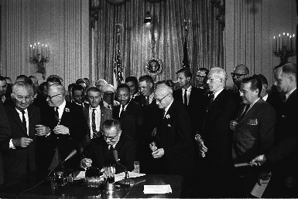
Executive Order 13166
Title VI
LIMITED ENGLISH PROFICIENT
MEANINGFUL ACCESS

Slide 5
EFFECTIVE COMMUNICATION
Americans with Disabilities Act (ADA)
Title III
DEAF AND HARD OF HEARING
Notes:
https://www.ada.gov/ada_title_III.htm

Slide 6
WORKING WITH SURVIVORS WITH LEP: LAYING THE FOUNDATION
1. Familiarize yourself with the language groups in your service area
Use demographic and organizational internal data to assess and keep track of LEP groups present in your area.
LEP maps: http://www.lep.gov/maps
2. Build relationships with local victim services organizations and technical assistance providers
Advocates can connect survivor to other culturally and linguistically relevant resources end ensure the survivor gets services they need while you focus on the legal case.
Identify local community based and culturally-specific victim service providers that serve survivors with LEP in your area.
Utilize national or local resources to build your capacity on working with LEP survivors.
Office of Violence Against Women TA Provider Directory: https://ta2ta.org/directory.html
3. Budget for language access
Include a line item for language support in your budget all grant proposals and apply for grants specifically for language access work.
Use data (above) to show why it matters.
Clients should not pay or should not be charged for language support!

Slide 7
Increase your capacity to understand how language and trauma intersect
Perpetrators may use their language privilege to isolate survivors. Also, perpetrators often can use their speaking skills and are able to navigate through the cumbersome legal system which they use to continue the violence even after leaving the relationship.
NIWAP, et al., Ensuring Language Access to Immigrant Victims of Sexual Assault
https://vawnet.org/material/ensuring-language-access-immigrant-victims-sexual-assault
Encuentro Latino, National Institute on Family Violence, Language Access and Domestic Violence: Communicating with Limited English Proficient Individuals
https://vawnet.org/material/language-access-and-domestic-violence-communicating-limited-english-proficient-individuals
Asian Pacific Institute on Gender-Based Violence, Are we doing what we think we’re doing? Providing Trauma Informed Language Accessible Services
https://advocacyinactionnm.org/wp-content/uploads/2017/02/Trauma-informed-Interpretation.pdf
Develop relationships with translation and interpretation agencies that train staff on implicit bias, domestic violence and sexual assault dynamics, and effects of abuse
Promising Practices:
Ayuda Language Services (DC area)
https://ayuda.com/what-we-do/language-services/#1525657165588-19a63918-e5d5
AshaKiran (Alabama)
http://ashakiran.com/Jul2017/trauma-informed-interpreting-2
Breaking the Silence curriculum
https://www.ata-chronicle.online/cover-feature/breaking-silence-what-interpreters-need-to-know-about-victim%E2%80%A8services-interpreting/#sthash.CW5GqqI4.dpbs

Slide 8
PLANNING FOR THE ENCOUNTER
Determine your client’s primary language or means of communication
Do not assume fluency in spoken languages or American Sign Language (ASL)
Have language identification tools available:
DHS I speak cards/posters: https://www.dhs.gov/xlibrary/assets/crcl/crcl-i-speak-poster.pdf
Design your own: http://healthtranslations.vic.gov.au/bhcv2/bhcht.nsf/findyourlanguage?openform
Do not assume literacy or formal academic instruction
Prepare to work with interpreters and translators
Know the difference between interpretation and translation:
Interpreter: Renders a message from one into another spoken or sign language
Translator: Takes the written word in one language and converts into written word in another language
Follow Promising Practices when Working for Interpreters:
API-GBV Working with Interpreters Tip Sheet: https://www.api-gbv.org/resources/working-with-interpreters/
Examining Witnesses through and Interpreter
SDNY Interpreters Office: https://www.wascla.org/library/item.389482-For_Attorneys_Examining_Witnesses_through_and_Interpreter

Slide 9
Prepare form and document translations in advance
Invest in translating most commonly used forms and documents, update translation when needed.
National Center for State Courts, Guide to Translation of Legal Materials
https://www.ncsc.org/education-and-careers/state-interpreter-certification/~/media/files/pdf/education%20and%20careers/state%20interpreter%20certification/guide%20to%20translation%20practices%206-14-11.ashx
Prepare the survivor to work with interpreters
Assess survivor’s preferences- do they have age or gender preference for the interpreter. Having an interpreter that triggers traumatic memories will be not conducive to achieve safe-seeking and healing survivor’s goals.
API-GBV, Considerations when Using Interpreters for Victims with Limited English Proficiency:
https://www.api-gbv.org/resources/limited-english-proficiency/
5. Brief the interpreters about the encounter with the survivor
Prepare interpreters by explaining the purpose of the encounter, participants profile and for the potential of asking delicate questions or receiving sensitive answers. Safety, confidentiality, empowerment, choice and self-determination are critical aspects that you need to ensure interpreters safeguard when working with domestic violence/sexual assault victims.
Ayuda, Working with Interpreters Outside of the Courtroom: A Guide for Attorneys
https://ayuda.com/wp-content/uploads/2017/06/Working_With_Interpreters_2016.pdf
Working with Interpreters: Service Provision with Torture Survivors, https://gulfcoastjewishfamilyandcommunityservices.org/wp-content/uploads/2018/04/Working-with-Interpreters.pdf

Slide 10
Provide key materials in advance to interpreters so they can prepare and study the terminology to be used
Ayuda, A Glossary of Victim Services Terminology,
https://ayuda.com/wp-content/uploads/2016/07/156617_Ayuda_Glossary_BreakingSilence-WEB.pdf
6. Familiarize yourself with Interpreter’s Ethics and Professional Responsibilities
Legal interpreters are subject to codes of ethical practice. Confidentiality, accuracy and completeness in interpretation can be a matter of life and death for victims of domestic violence, especially in remote communities. Learn about interpreter’s duties, protocols and standards to ensure the interpreters you work with adhere to them.
NAJIT, Code of Ethics and Professional Responsibilities, https://najit.org/wp-content/uploads/2016/09/NAJITCodeofEthicsFINAL.pdf
Uekert, B. K., Peters, et al., Code of Professional Responsibility for Interpreters Serving LEP Victims of Domestic Violence, https://www.nationallatinonetwork.org/images/Code_of_Professional_Responsibility_for_Interpreters_-DV_cases.pdf

Slide 11
DURING THE ENCOUNTER
1. Facilitate a pre-session with your client and the interpreter, arrange appropriate seating
Explain confidentiality, roles and responsibilities as well as basic guidelines on how the session will transpire.
API-GBV, Resource Guide for Advocates and Attorneys on Interpretation Services for Domestic Violence Victims,
https://www.api-gbv.org/resources/interpretation-resource-guide/
2. Use Plain Language
Do not expect interpreters to change your words. To ensure survivors are able to understand clearly what you are trying to convey, and to achieve a more concise and effective communication, use plain language.
The Plain Language Action and Information Network, Plain Language in the Legal Profession, https://www.plainlanguage.gov/resources/content-types/legal-profession/
3. Follow Interpretation Protocols for Legal Proceedings
"Listen with your Eyes“ - How can you monitor the Interpretation? https://nmcenterforlanguageaccess.org/cms/en/courts-agencies/judges-portal/how-to-monitor-interpretation

Slide 12
AFTER THE ENCOUNTER
Evaluate interpreter's performance
Evaluation sample: https://www.veipd.org/main/pdf/dbhds_interpreter_evaluation_form_dec_2011.pdf
2. Discuss any difficulties or concerns with client

Slide 13
QUESTIONS

Slide 14
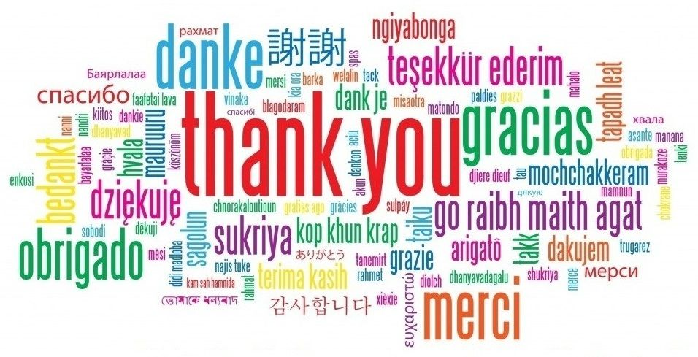
Thank you and see you tomorrow!

